Slide 1

DEEP NEURAL NETWORK
MODULE # 5 : DEEP FEED-FORWARD NEURAL NETWORKS
DNN Team
BITS Pilani WILP

Slide 2
The instructor is gratefully acknowledging the authors who made their course materials freely available online.
This deck is prepared by Seetha Parameswaran.
Deep Learning

Slide 3









Table of Contents
Motivation: The XOR Problem
Non-Linearity in Neural Networks
The Four Components of DFNN
Training DFNN
Making Predictions
Impact of Depth and Width
DFNN Architecture Design Implementation Tips
Summary
1
2
3
4
5
6
7
8
9
Deep Learning

Slide 4
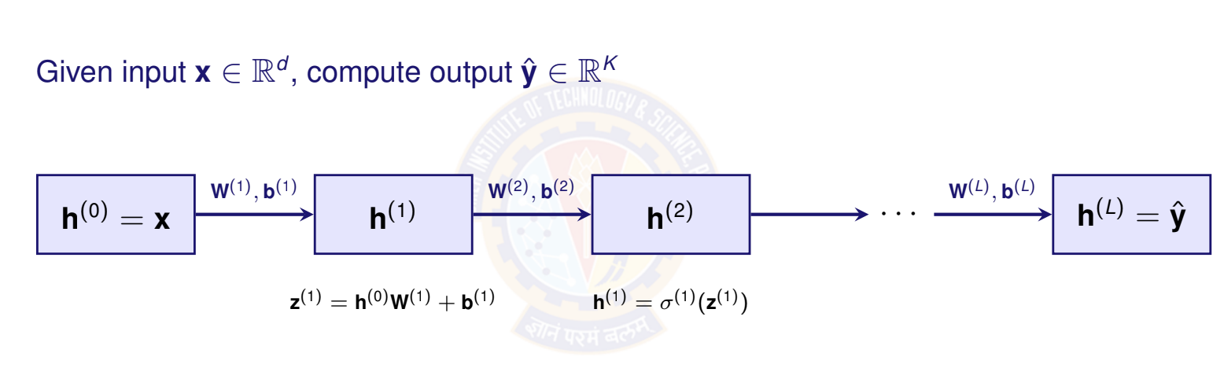
Forward Pass: Computing Predictions
Deep Learning

Slide 5
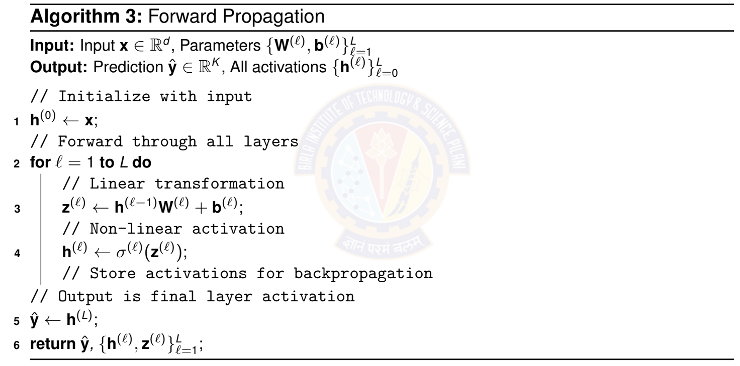
Forward Pass Algorithm
Deep Learning

Slide 6
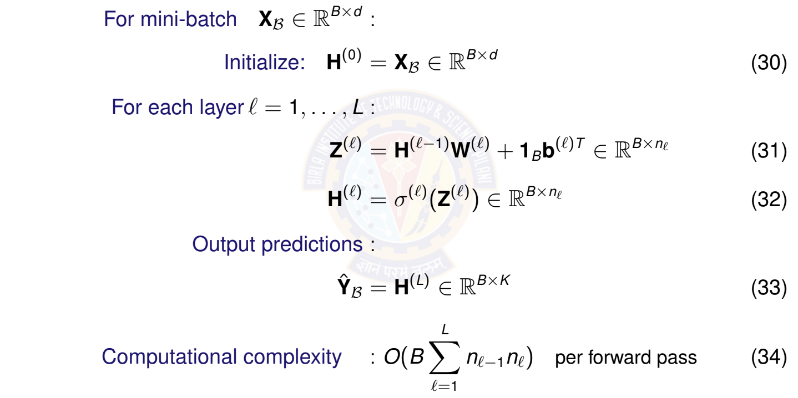
Forward Pass: Vectorized for Mini-Batch
Deep Learning

Slide 7
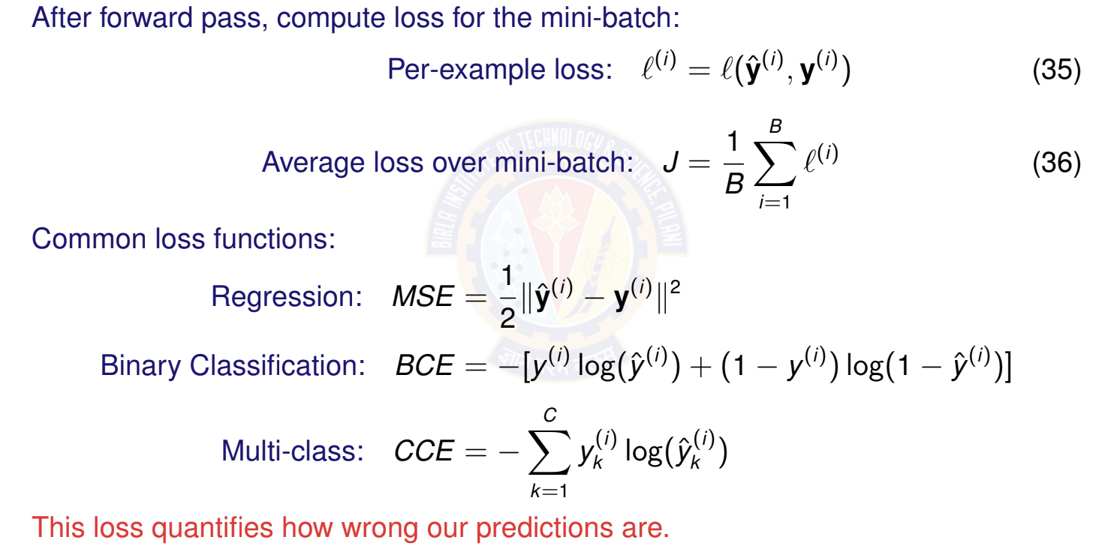
Loss Computation
Deep Learning

Slide 8
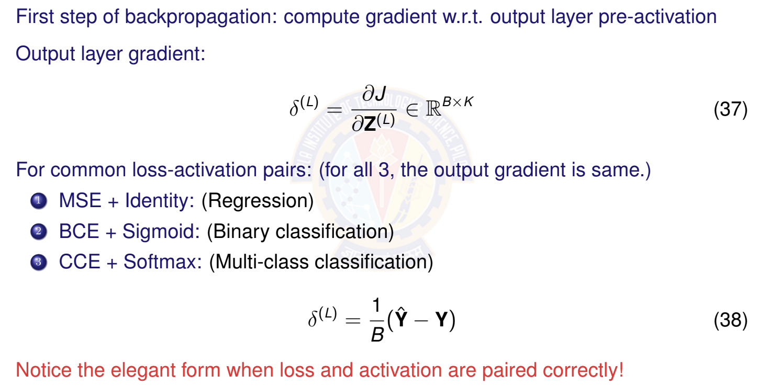
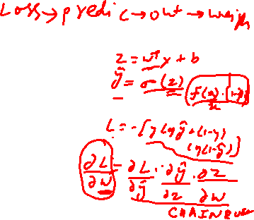
Output Layer Gradient
Deep Learning
Notes:
J is cost function, Z(L) is weighted input of the final layer L
∈ℝ𝐵×𝐾 specifies the dimensions of the resulting matrix

Slide 9
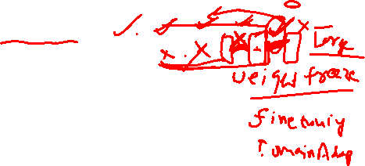
Backpropagation: The Key Algorithm
Purpose
Backpropagation efficiently computes gradients of the loss w.r.t. all parameters by applying the chain rule backward through the network.
Key insight: Use chain rule recursively Notation: Define error signal for layer l:
_{δ}(l) ₌
∂J
_{∈ R}B×n_{Æ}
_{∂Z}(l)
(39)
Two main steps:
1
Backpropagate error signals: δ^{(L)} → δ^{(L—1)} → · · · → δ⁽¹⁾
2
Compute parameter gradients using error signals
Deep Learning

Slide 10
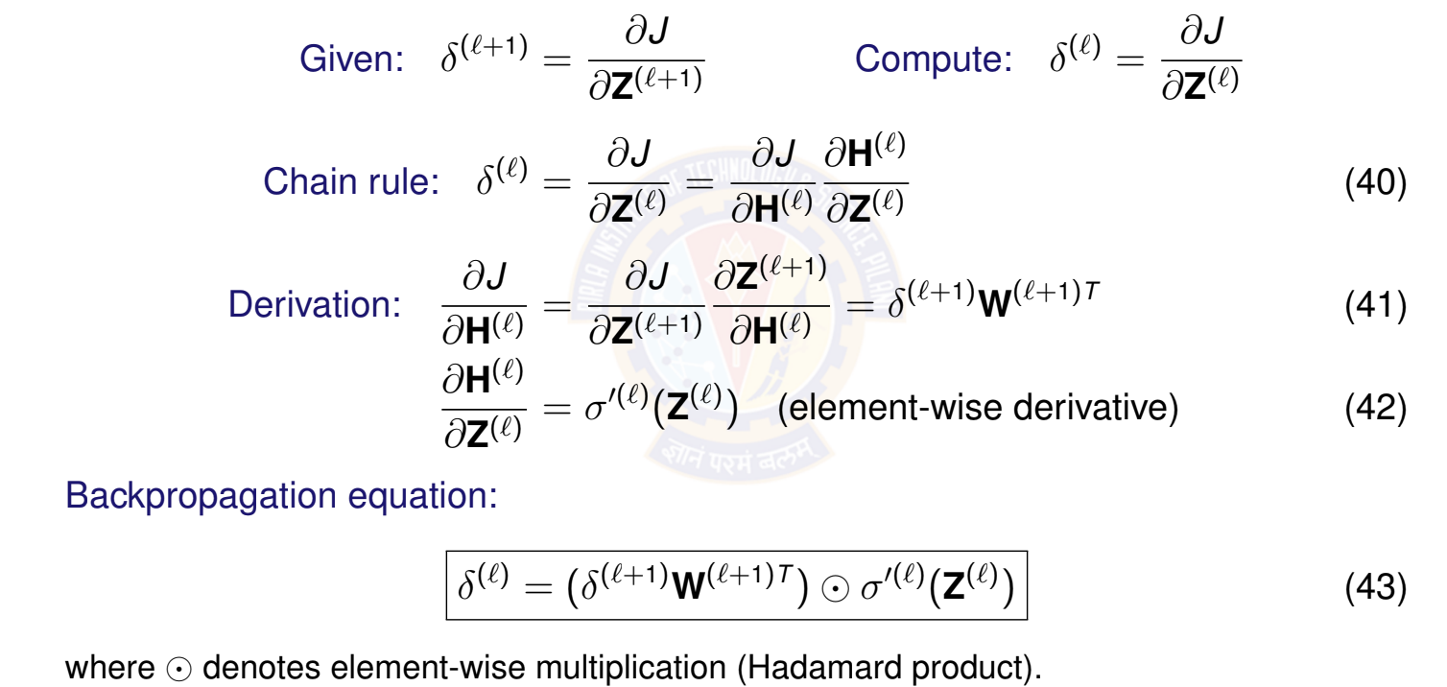
Backpropagating Error Signals
Deep Learning
34 / 67
Notes:
𝐇(𝑙) is the output (activations) of the 𝑙-th layer.
𝐙(𝑙) is the input to the activation function (pre-activation) in the 𝑙-th layer.
𝜎(𝑙) is the activation function used in the 𝑙-th layer.
𝜎′(𝑙) denotes the derivative of the activation function 𝜎(𝑙)

Slide 11
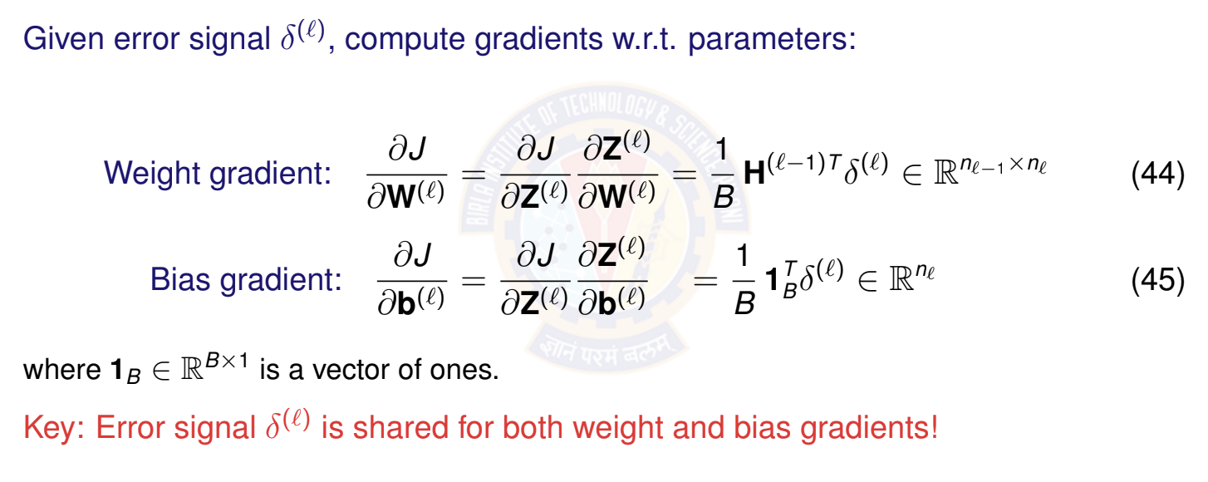
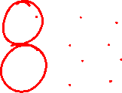
Computing Parameter Gradients
Deep Learning

Slide 12
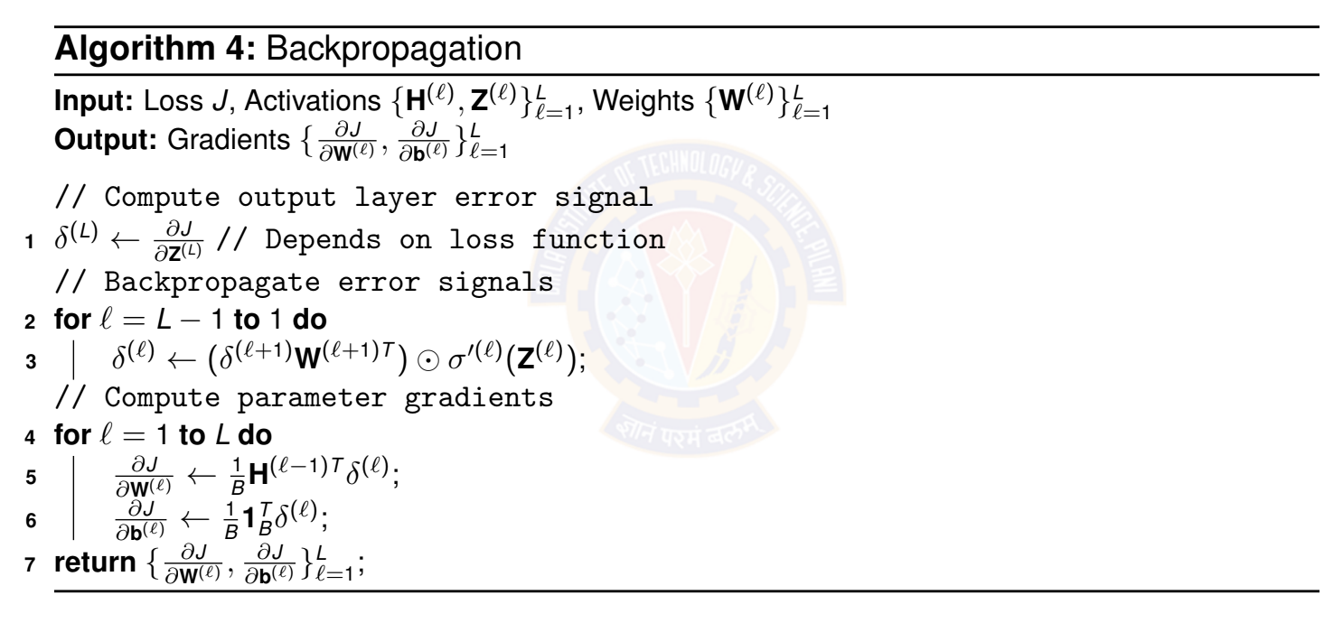
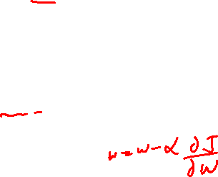
Backpropagation Algorithm
Deep Learning

Slide 13
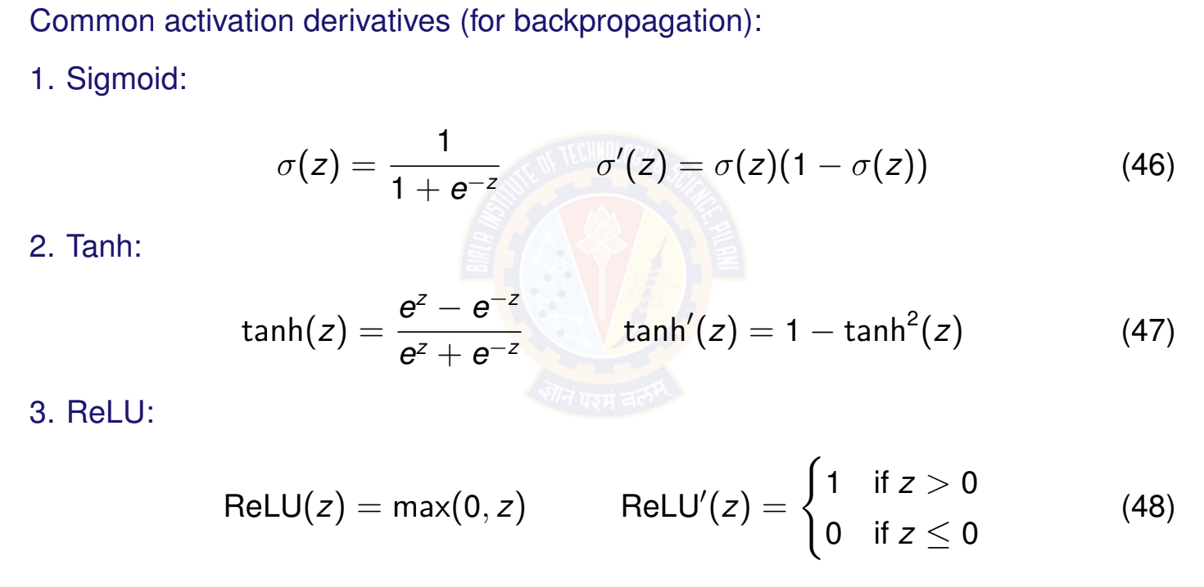

Activation Function Derivatives
Deep Learning

Slide 14
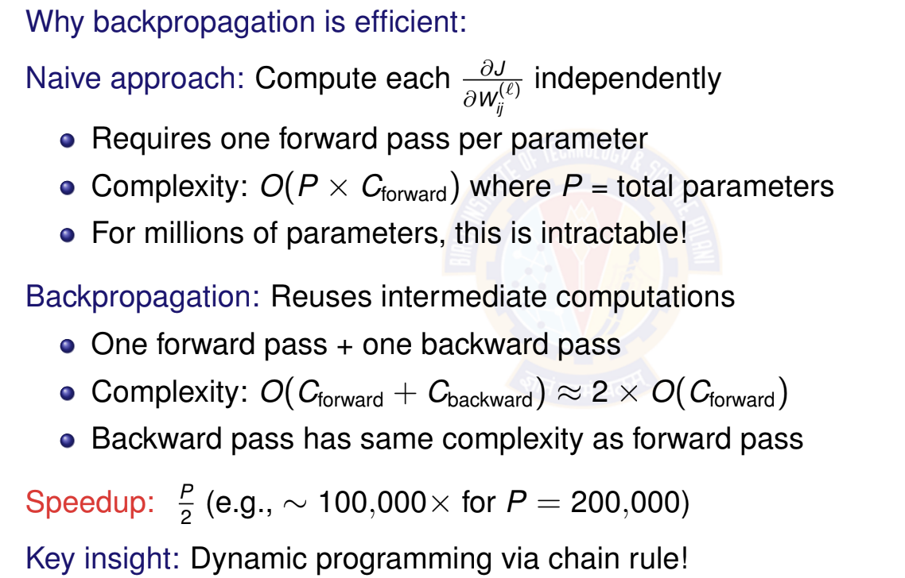
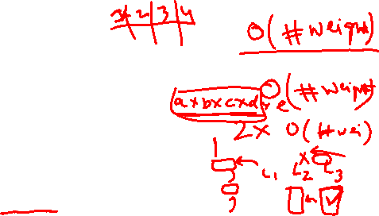
Computational Efficiency of Backpropagation
Deep Learning

Slide 15

Parameter Update Step
After computing gradients, update all parameters:
For each layer l = 1, . . . , L: (Vector form for single example)
_{W}(l) _{← W}(l) _{− ηh}(l—1)T _{δ}(l)
_{b}(l) _{← b}(l) _{− ηδ}(l)
(49)
(50)
where η > 0 is the learning rate.
This moves parameters in the direction that reduces the loss!
Deep Learning

Slide 16
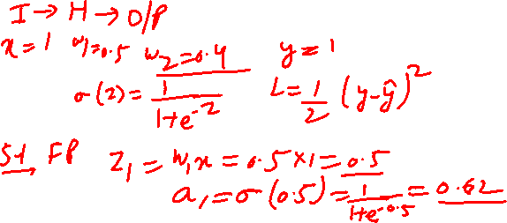


Slide 17
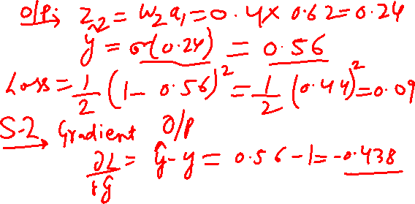

Slide 18
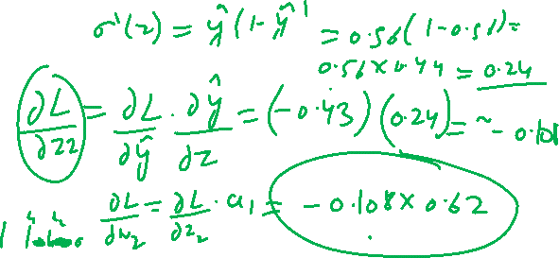

Slide 19
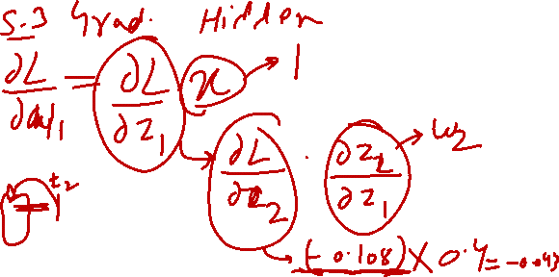

Slide 20
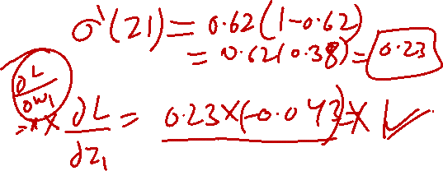

Slide 22


Table of Contents
Motivation: The XOR Problem
Non-Linearity in Neural Networks
The Four Components of DFNN
Training DFNN
Making Predictions
Impact of Depth and Width
DFNN Architecture Design Implementation Tips
Summary
1
2
3
4
5
6
7
8
9
Deep Learning

Slide 23
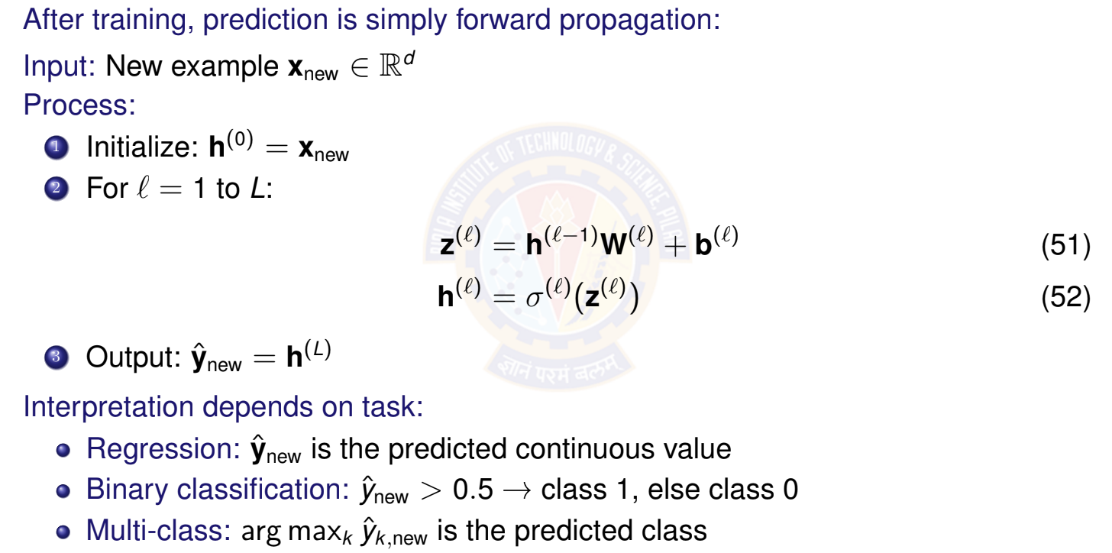
Using Trained DFNN for Prediction
Deep Learning

Slide 24
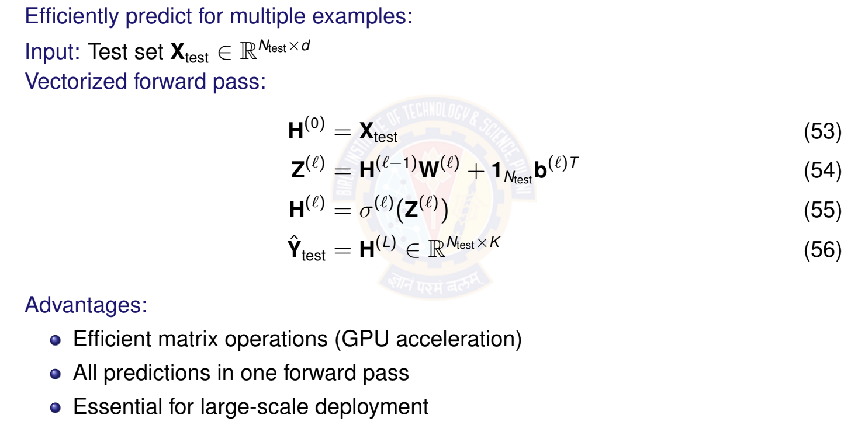
Batch Prediction
Deep Learning

Slide 25

Table of Contents
Motivation: The XOR Problem
Non-Linearity in Neural Networks
The Four Components of DFNN
Training DFNN
Making Predictions
Impact of Depth and Width
DFNN Architecture Design Implementation Tips
Summary
1
2
3
4
5
6
7
8
9
Deep Learning

Slide 26


Network Depth vs Width
Two ways to increase model capacity:
Width (more units per layer):
Depth (more layers):
Wide
Deep
Properties:
Hierarchical features More expressive Better generalization
Properties:
More parallel features Higher capacity
Risk of overfitting
Deep Learning

Slide 27
Why Depth Matters?
Deep networks learn hierarchical representations:
Simple
Low-level features (edges, textures)
Deep networks can represent exponentially more functions than shallow ones with the same number of parameters!
Mid-level features (parts, shapes)
Complex
High-level features (objects, concepts)
Example: Image classification
Layer 1: Detect edges and colors
Layer 2: Combine into textures and simple shapes Layer 3: Recognize object parts (eyes, wheels) Layer 4+: Identify complete objects (faces, cars)
Deep Learning

Slide 28
Universal Approximation Theorem
Theorem (Cybenko, 1989; Hornik et al., 1989)
A feed-forward network with a single hidden layer containing a finite number of neurons can approximate any continuous function on a compact subset of R^{n} , given an appropriate activation function.
What this means:
Theoretically, even shallow networks are powerful BUT: May require exponentially many hidden units Deep networks are much more parameter-efficient
Practice:
Deep networks learn better representations Achieve better performance with fewer parameters Generalize better to new data
Depth enables efficient learning of hierarchical structure!
Deep Learning
46 / 67

Slide 29
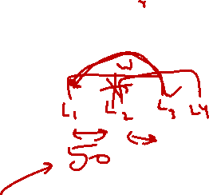
Challenges with Very Deep Networks
Problems that arise with increasing depth:
Vanishing Gradients:
Gradients become exponentially small in early layers Network fails to learn useful features
Solution: ReLU activations, careful initialization, normalization
Exploding Gradients:
Gradients become exponentially large Causes numerical instability (NaN/Inf values)
Solution: Gradient clipping, proper initialization
Degradation Problem:
Very deep networks harder to optimize Training error may increase with depth
Solution: Residual connections (ResNets), skip connections
Deep Learning

Slide 30

Table of Contents
Motivation: The XOR Problem
Non-Linearity in Neural Networks
The Four Components of DFNN
Training DFNN
Making Predictions
Impact of Depth and Width
DFNN Architecture Design Implementation Tips
Summary
1
2
3
4
5
6
7
8
9
Deep Learning

Slide 31
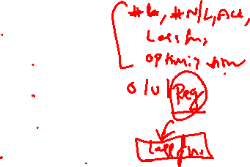
Design Considerations
Key decisions when designing a DFNN:
Number of layers L
> How deep should the network be?
Units per layer n₁, n₂, . . . , n_{L}
> How wide should each layer be?
Activation functions σ^{(l)}
> Which non-linearity for each layer?
Output layer design
> Depends on task (regression vs classification)
Regularization
> How to prevent overfitting?
1
2
3
4
5
No universal answer - depends on problem, data, and computational resources!
Deep Learning

Slide 32
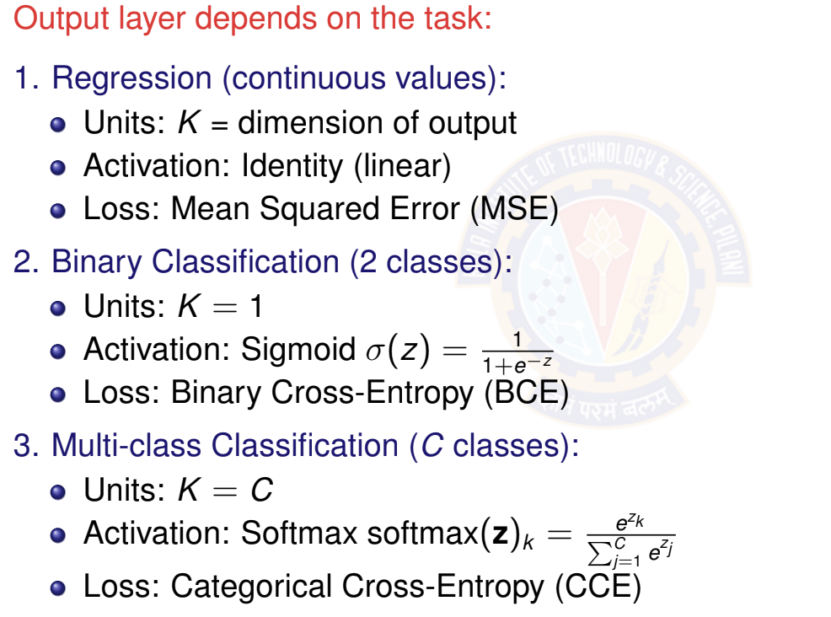

Output Layer Design
Deep Learning

Slide 33
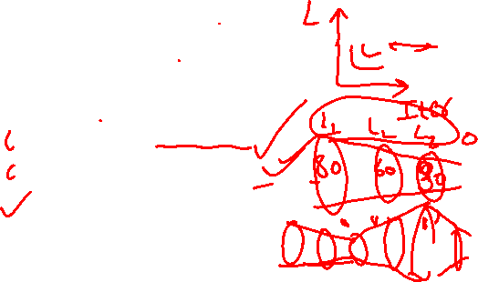
General Architecture Guidelines
1. Start Simple:
Begin with 2-3 hidden layers
10-100 units per layer (depending on problem scale)
Gradually increase complexity if needed
Common Patterns:
Decreasing width: n₁ > n₂ > · · · > n_{L}
> Funnel architecture (compression)
Constant width: n₁ = n₂ = · · · = n_{L—1}
> Uniform representation
Hourglass: Wide → Narrow → Wide
> Learns compressed representations
Scale with Data:
More data → can support larger networks
Less data → keep networks smaller to avoid overfitting
Deep Learning
51 / 67

Slide 34

Hidden Layer Activation Functions
Activation | When to Use | Avoid When
ReLU | Default choice Fast, no vanishing gradient | Very deep networks (dying ReLU)
Leaky ReLU | Deep networks Fixes dying ReLU | Never (safe choice)
Tanh | Small networks Zero-centered | Very deep networks (vanishing gradient)
Sigmoid | Avoid for hidden layers (only for binary output) | Hidden layers (strong saturation)
Modern recommendation:
Default: ReLU for hidden layers
Alternative: Leaky ReLU, ELU for very deep networks
Avoid: Sigmoid/Tanh in hidden layers (unless specific reason)
Deep Learning

Slide 35
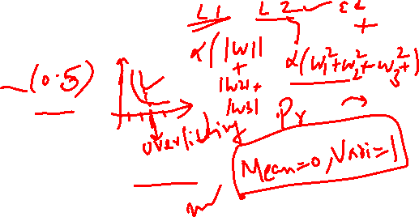
Regularization Techniques
Prevent overfitting with:
L2 Regularization (Weight Decay):
Dropout:
Early Stopping:
Batch Normalization:
Note: You will learn about this in Module 10 and 11
Deep Learning

Slide 36

Table of Contents
Motivation: The XOR Problem
Non-Linearity in Neural Networks
The Four Components of DFNN
Training DFNN
Making Predictions
Impact of Depth and Width
DFNN Architecture Design Implementation Tips
Summary
1
2
3
4
5
6
7
8
9
Deep Learning

Slide 37

Parameter Initialization
Proper initialization is critical for training success!
x Bad: Zero initialization
Good: Random initialization
Xavier/Glorot Initialization for Sigmoid / Tanh He Initialization for ReLU
Biases: Initialize to zero: b^{(l)} = 0
Note: You will learn about this in Module 10 and 11
Deep Learning

Slide 38

Training Hyperparameters to Tune
Learning Rate η:
Start with: η ∈ {0.001, 0.01, 0.1}
Consider adaptive methods (Adam with η = 0.001)
Batch Size B:
Common: B ∈ {32, 64, 128, 256}
Larger batch → faster but may hurt generalization Smaller batch → better generalization but slower Limited by GPU memory
Number of Epochs T :
Use early stopping based on validation loss Typically 50-200 epochs for moderate datasets Monitor for overfitting
Deep Learning

Slide 39
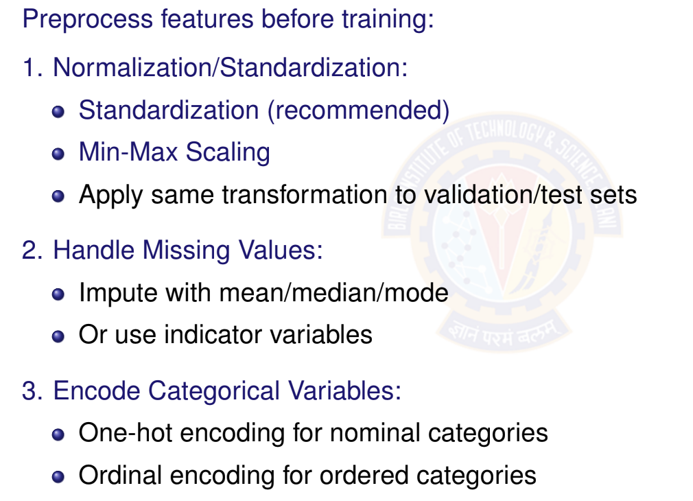
Feature Preprocessing
Deep Learning
57 / 67

Slide 40
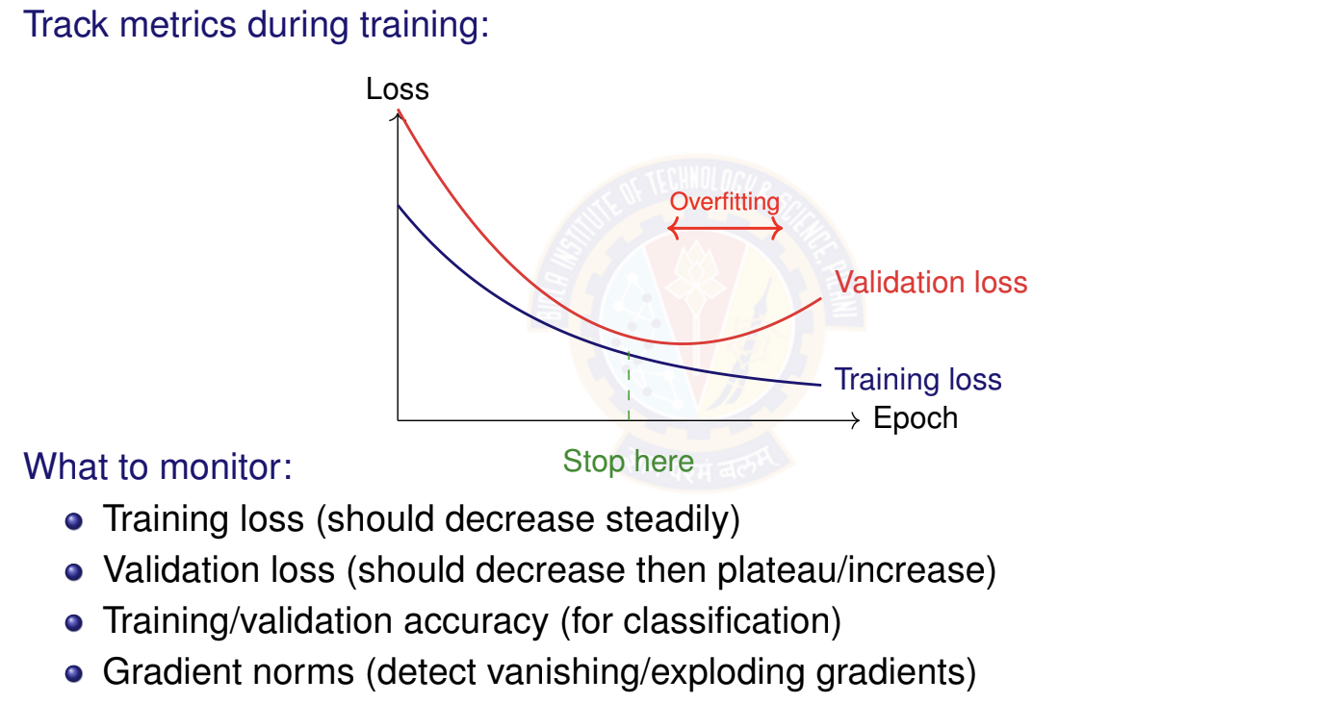
Monitoring Training Progress
Deep Learning

Slide 41
Diagnosing Training Issues
Symptom | Diagnosis | Solution
Loss = NaN/Inf | Numerical instability | Decrease η, check gradients, normalize inputs
Loss not decreas- ing | Learning rate too small OR bug | Increase η, verify gradient computation
Loss oscillating | Learning rate too large | Decrease η, use learning rate schedule
Training loss ↓, validation loss ↑ | Overfitting | Add regularization, dropout, more data
Both losses high | Underfitting | Increase capacity (wider/deeper), train longer
Slow convergence | Poor initialization OR bad features | Use proper init (He/Xavier), normalize features
Gradients → 0 | Vanishing gradients | Use ReLU, better init, batch normalization
Gradients → ∞ | Exploding gradients | Gradient clipping, decrease η
Deep Learning

Slide 42
Debugging Checklist
Before training:
Features normalized/standardized Data split into train/val/test
Output layer matches task (sigmoid for binary, softmax for multi-class) Loss function matches output activation
Weights initialized properly (not all zeros!)
During training:
Loss decreasing on training set Validation loss tracked separately Gradients neither vanishing nor exploding No NaN/Inf values in loss or activations Training accuracy improving
Sanity checks:
Try overfitting a small batch (should reach 0 loss) Verify shapes of all matrices/tensors
Test forward pass before adding backprop
Deep Learning

Slide 43
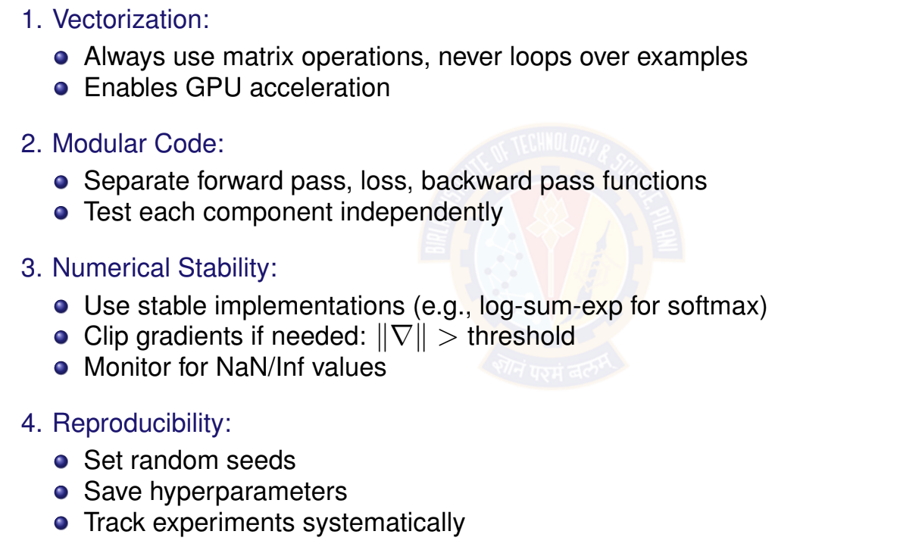
Implementation Best Practices
Deep Learning

Slide 44

Table of Contents
Motivation: The XOR Problem
Non-Linearity in Neural Networks
The Four Components of DFNN
Training DFNN
Making Predictions
Impact of Depth and Width
DFNN Architecture Design
Implementation Tips
Summary
1
2
3
4
5
6
7
8
9
Deep Learning

Slide 45
Key Takeaways
Non-linearity is essential for learning complex patterns; without it, deep networks collapse to linear models.
DFNN = stacked layers with non-linear activations, enabling hierarchical feature learning.
Four components: Data, Model (architecture), Objective (loss), Learning (backpropagation + SGD).
Backpropagation efficiently computes gradients using chain rule; enables training deep networks.
Depth enables learning hierarchical features and improves expressiveness. Width increases capacity within each layer but requires more data.
Proper initialization, normalization, and regularization are critical for successful training.
ReLU is the default activation for hidden layers; use task-specific activations for output.
Deep Learning

Slide 46
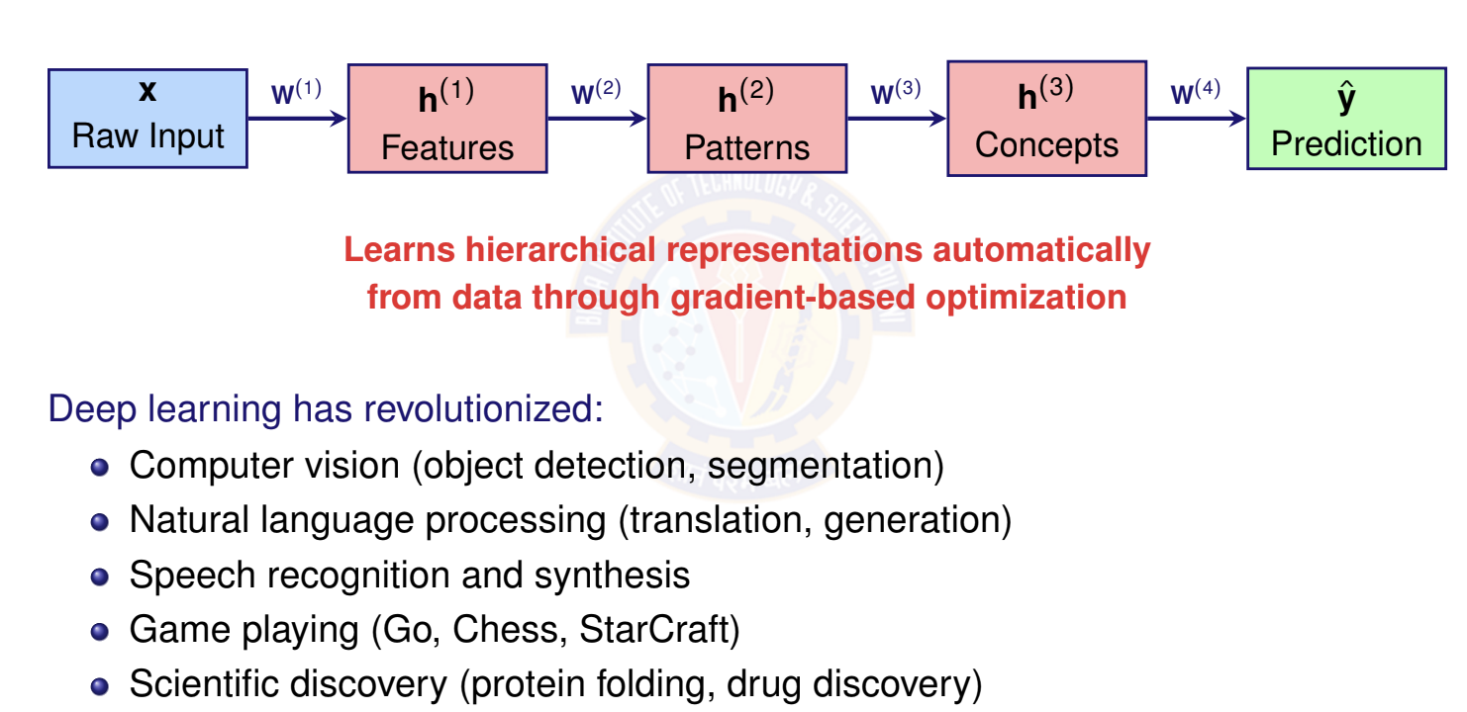
The Power of Deep Learning
Deep Learning

Slide 47
What Next?
Specialized Architectures:
Convolutional Neural Networks (CNNs): For images and spatial data Recurrent Neural Networks (RNNs): For sequences and time series Transformers: For attention-based models (GPT, BERT)
Graph Neural Networks: For graph-structured data
Advanced Topics:
Optimization algorithms (Adam, RMSprop, AdaGrad) Advanced regularization (Dropout, Batch Normalization) Transfer learning and pre-training
Model interpretability and explainability Efficient inference and model compression
DFNNs are the foundation - master them first!
Deep Learning
65 / 67

Slide 48
To become Proficient
Implement from scratch:
Write forward pass, backpropagation manually Verify with gradient checking
Train on simple datasets (XOR, MNIST)
Use frameworks effectively:
PyTorch, TensorFlow, JAX handle backprop automatically But understanding the math makes debugging easier Focus on architecture design and hyperparameter tuning
Experiment and iterate:
Start simple, gradually increase complexity Track experiments systematically
Learn from failures (most time spent debugging!)
Study successful architectures:
Read papers, examine code implementations Understand design choices and motivations
Deep Learning

Slide 49

References
Goodfellow et al. ”Deep Learning” - Chapter 6
http://www.deeplearningbook.org/
Zhang et al. ”Dive into Deep Learning” - Chapters 4, 5 https://d2l.ai/ Nielsen, M. ”Neural Networks and Deep Learning”
http://neuralnetworksanddeeplearning.com/
Deep Learning

Slide 50
